Slide 1
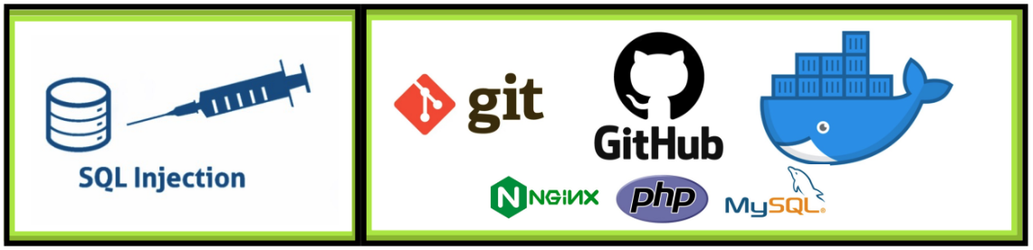
git/Docker/SQL Injection
This lab is for educational purposes. Performing hack attempts (without permission) on computers that you do not own is illegal.
Notes:
Thank Director Ingmire
Talk about my first job at PWPL 1995

Slide 2
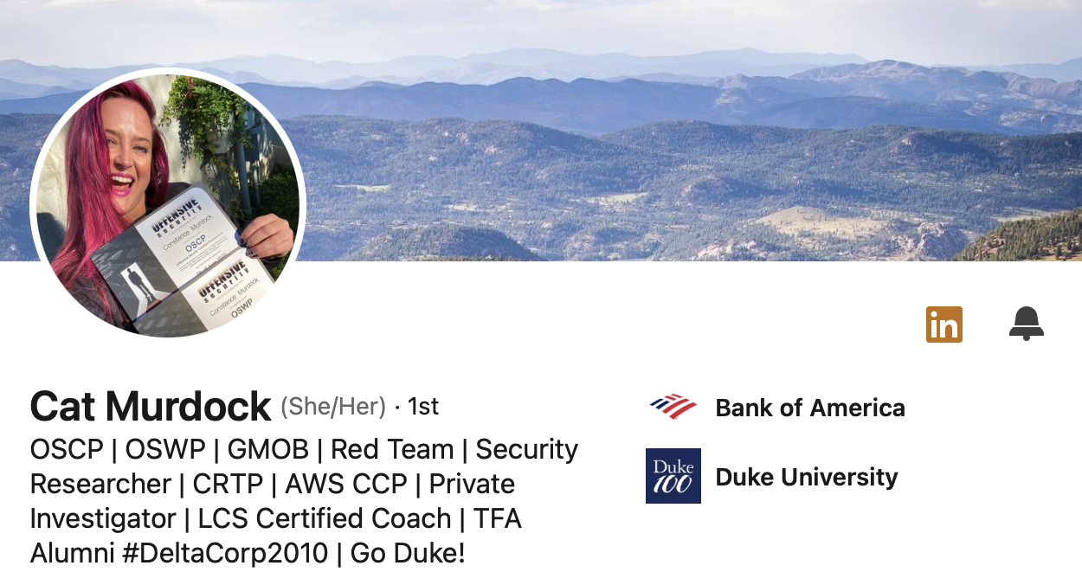
Cat Murdock
Headshot and Bio
Notes:
Play Video

Slide 3

Distributed version control system
Tracks changes to computer files
Great for coordinating programming teams working on source code and software development
Repositories can:
Hosted on the web - GitHub. Great for open-source projects. Allows forking!
Hosted on-prem for Enterprise development within an organization
Benefits
Unlike SVN, users can work on on a file simultaneously as long as they are not working on the same line of code.
Contains merge functionality
Great resource for researching CVEs and other cyber exploitation projects.
Pre-installed on LINUX and Mac OS. Must be installed on Windows
Notes:
Play Video

Slide 4

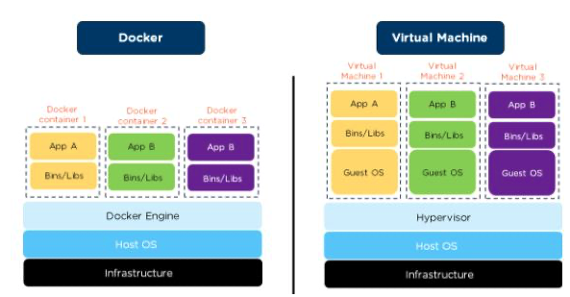
Docker
Treat your servers like ‘cattle’ not like ‘pets’
Think Virtual machines but lighter weight
Highly scalable and highly transportable
Notes:
Play Video

Slide 5
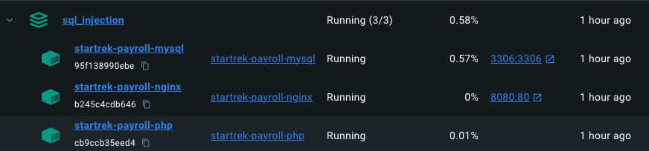
Docker
Applications are stored in containers
NGINX - Web Server
PHP - Server-side scripting language and porocesor
MySQL - SQL Server Daemon
You can create multi-container applications on top of lightweight LINUX distros or simply the required Bins/Libs
Allows developers to have the same baseline on their local desktop as in production.
You can tie networks together and present ports to localhost for testing
Data in containers is not persistent unless you want it to be.
Use Kubernetes to orchestrate/load balance/spawn production environments.
Notes:
Play Video

Slide 6
Docker
Docker has a CLI and a GUI called Docker Desktop
Integrates with Docker Hub where people share open-source containers and projects.
A lot of Docker Projects are also stored on GitHub
In terms of cybersecurity, there are a lot of great Docker containers that you can use to explore vulnerabilities
VulnHub
Search a CVE of interest.
From a DefSec perspective, Docker Desktop also presents known vulnerabilities in the images you are using!
Notes:
Play Video

Slide 7

Let’s Dig In !!!
The first thing we will do is open a terminal and clone the NMU Cyber - SQL Injection Repository
Open the terminal
type: cd repos
List the contents of the directory type: ls -l
Notice the directory is empty
Now, we will clone the git repository using this command:
git clone https://github.com/nmucyber/NMU_SQL_Injection.git
If we type: ls -l again, we will now see a sub-directory in repos called NMU_SQL_Injection
Let's go to that directory and look at the contents using these commands:
cd NMU_SQL_Injection
ls -l
Now, we have a version-controlled copy of the GitHub repository on our local machine. Any changes we make we can commit back to GitHub.
Notes:
Play Video

Slide 8
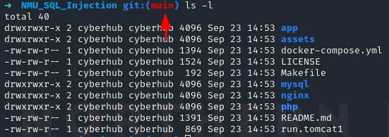
Let’s Dig In !!!
You will notice that the terminal prompt changes to let us know we are in a git-controlled folder
Let’s examine the docker compose.yml file before we build our containers
type: mousepad docker-compose.yml &
Notes:
Play Video

Slide 9
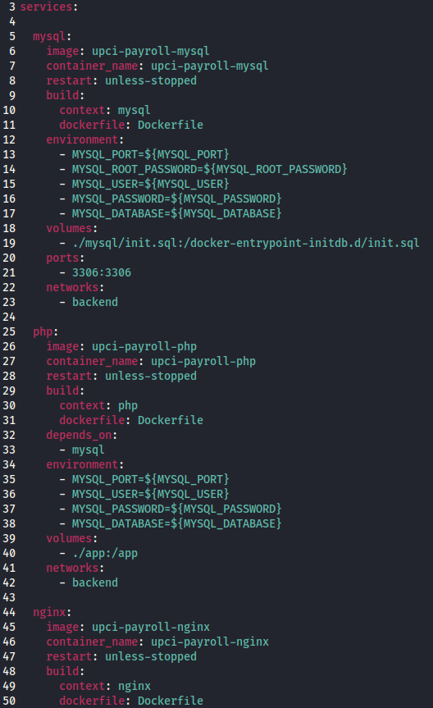
We can see this will install three services
mysql (open-source relational database)
php (open-source server-side scripting)
nginx (open-source web daemon)
Here, we can open ports outside of the docker container.
Create volumes to our local filesystem from the docker container. This is great for development as any changes we make in our local filesystem will be reflected in the docker container and vice-versa. The volume can map to a whole folder or a specific file.
You will also notice that each service has a context attribute that corresponds to a subdirectory.
Close the mousepad text editor.
Type: cd mysql ls -l
In each of the service subdirectories, you will see a Dockerfile. This tells Docker what image and version to run.
If we type: cat Dockerfile
We can see that Docker will pull version 8.3.0 of the MySQL image
Notes:
Play Video

Slide 10
Let’s build our docker containers
Move back to the NMU_SQL_Injection directory by typing: cd .. To confirm what directory you are in you can type: pwd
Open the Docker Desktop by double-clicking the icon on the Desktop.
To build and run the Docker service, we will type: docker compose up – build in the terminal.
Docker will then go out and grab the necessary images to build the containers and start them on our local machine.
Just like that, we now have a fully functional web application running, albeit a very vulnerable one.
Alpine (a lightweight Linux distro that is only 5MB in size)
NGINX (web server daemon)
PHP (a server-side scripting environment)
MySQL (a relational database)
The beauty of docker is that it removes all the variables of developing on different systems and ensures your development team is working on a common baseline.
The docker containers can then easily be moved to AWS, Azure, or other cloud providers, and you know everything will be the same.
This is a double dash

Slide 11
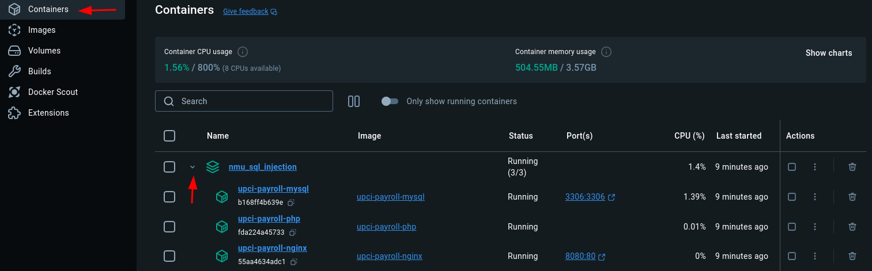
Docker Desktop (GUI)
Let's explore the Docker Desktop
Walk through:
Containers (our services) and the concept of a multi-container app
Stopping/ Starting a container.
Images (the packages docker downloaded to build our containers)
Ports (what are we exposing outside of the container)
Docker Scout (scanning an image for known vulnerabilities)

Slide 12
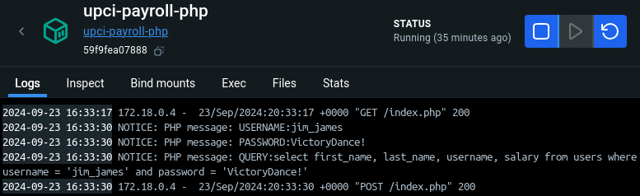

Exploring the Application
In the Docker Desktop click on the port hyperlink listed in the upci-payroll-nginx container
This will open a web browser to the applications login page
Type in some gibberish for username and password and notice that no data is returned.
Click the back button on the browser
Now, let’s try some real credentials
Username: jim_james
Password: VictoryDance!
We now see the salary information is displayed for that user
Go back to the Docker Desktop, and under containers, click on the upci_payroll-php hyperlink.
Now click on the Logs tab. Here, we can see how PHP is building the SQL to query the database

Slide 13

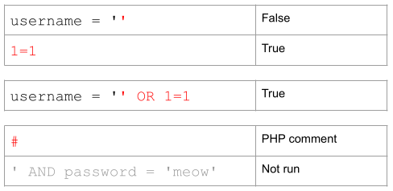
The SQL (Structured Query Language)
We can see that PHP is taking the web forms POST variables and building the query with them.
$user = $_POST[‘user’];
$pass = $_POST[‘password’];
SELECT first_name, last_name, username, salary FROM users where username = '$user’ and password = '$pass’
SQL Injection Attack Logic
Notice that username is blank. However, because of the ‘OR’ statement, 1=1 will evaluate as true. The ‘#” remarks out the rest of the SQL statement and password is not passed.

Slide 14
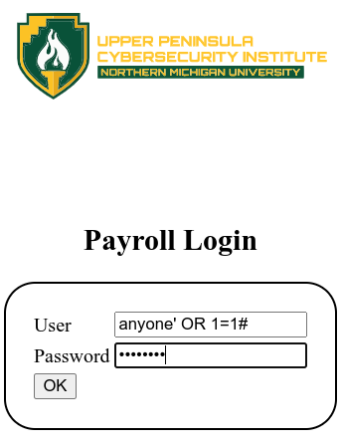
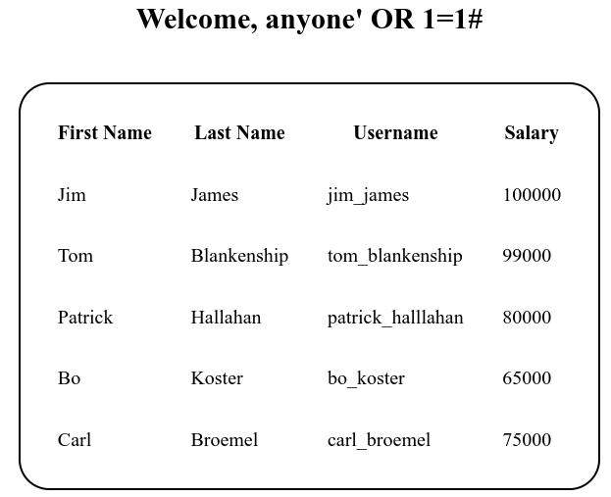
Demo: Attacking
In the Docker Desktop click on the port hyperlink listed in the upci-payroll-nginx container. This will open the application in the browser
Type in anything
Houston, we have a problem!

Slide 15
SQL Injection Mitigation
OWASP provide a SQL Injection Prevention Cheat Sheat
Primary defences:
Use of Prepared Statements
Use of Stored Procedures
Whitelist Input Validation
Escaping All User Supplied Input
Basic Premise: SANITIZE USER INPUT!
Stop the upci-payroll-nginx container
In the terminal type: cd ~/repos/NMU_SQL_Injection/app to change to that directory
Rename the index.php file by typing: mv index.php index_old.php
Rename the index_pdo.php file by typing: mv index_pdo.php index.php
This PHP file uses the PHP Data Object library and allows prepared statements
Restart the upci_payroll_nginx container
Retest and try to inject! Username = anyone’ OR 1=1# Password= anything

Slide 16
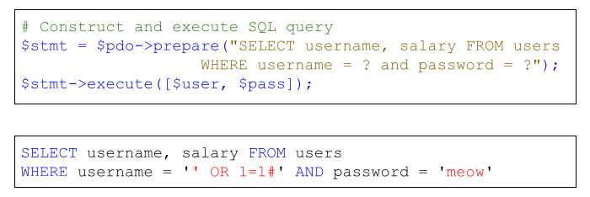
Prepared Statement Example
Notice that the prepared statement surrounds our injection in quotes and the vulnerability is mitigated.

Slide 17
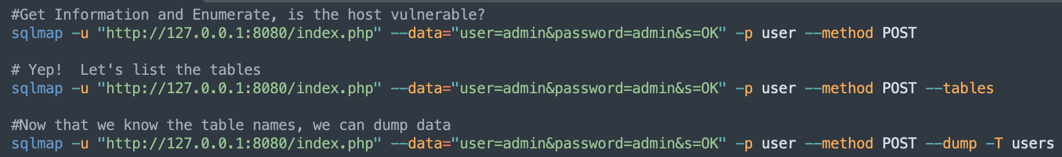
Optional If there is time: Discuss and Demo sqlmap tool in Kali Linux

Slide 18
Wrap Up
Thanks!
Questions?
Bonus Question: Can you name the Band whose members are in the UPCI Payroll Database?
This lab was forked and modified from Dr. Thomas Laurenson’s public GitHub repo on SQL Injections

